Slide 1


Slide 2


SPF RECORDS

Slide 3


Sender Policy Framework
• An eMail authentication method
• Simple to enable
• An open standard

Slide 4
Short History Of SPF
• 2000 First mention of an SPF idea
• 2002 SPF-like specification published
• 2003 RMX & DMP specifications merged
• 2004 Renamed to ‘Sender Policy Framework’ from ‘Sender Permitted From’ and MARID task group formed
• 2005 MARID group collapsed and revert to ‘classic’ SPF idea
• 2006 Experimental RFC published for SPF

Slide 5
What is a DNS SPF record?
A sender policy framework (SPF) record is a type of DNS TXT record that lists all the servers authorized to send emails from a particular domain.

Slide 6


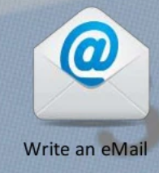

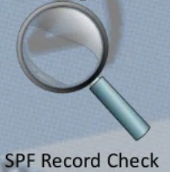





How does a mail server check an SPF record?

Slide 7
SPF Record Make Up
Three Sections
• Domain or Subdomain
• SPF Version
• The Mechanisms (Rules)
v=spf1 ip4=192.0.2.0 ip4=192.0.2.1 include:examplesender.email -all

Slide 8

SPF Version
The version prefix is pretty simple.
There can be multiple TXT records for a domain, this is the way to let parsers know that this is the record to be used for SPF checking.
SPF mechanisms
ip4=192.0.2.0 ip4=192.0.2.1
include:examplesender.email
-all

Slide 9
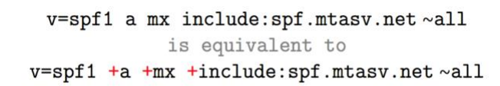
SPF qualifiers
+ Pass, an IP that matches a mechanism with this qualifier will pass SPF.
- Fail, an IP that matches a mechanism with this qualifier will fail SPF.
~ SoftFail, an IP that matches a mechanism with this qualifier will soft fail SPF, which means that the host should accept the mail, but mark it as an SPF failure.
? Neutral, an IP that matches a mechanism with this qualifier will neither pass or fail SPF.

Slide 10
How to Test Email Spoofing/Missing SPF Record Vulnerability?
Not having SPF (Sender Policy Framework) record for a domain may help an attacker to send spoofed email, which will look like, originated from the real domain.
Not only that, but this will also result in land emails in the SPAM box when SPF missing.

Slide 11
Let’s take a look at the following online tools to test the SPF records.
1.Kitterman :
SPF query tool by Kitterman allows you to quickly validate if the SPF record exists for a domain.
https://www.kitterman.com/spf/validate.html

Slide 12
2.MX Toolbox
MX Toolbox is another SPF record checker tool along with many other emails related lookup.
https://mxtoolbox.com/spf.aspx

Slide 13
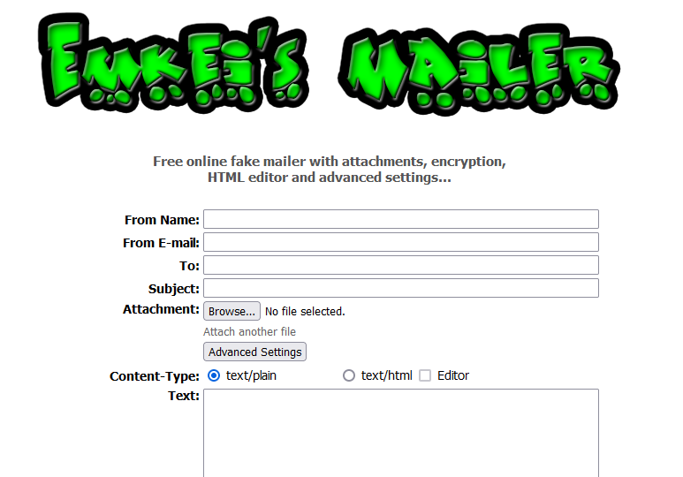
How to spoof the email of the any domain if there is no SPF records?
https://emkei.cz/

Slide 14
Thank you

